Slide 1
Algorithms: Design
CSE2003 - Module 1 & 2 Asymptotic Notations
C. Oswald
VIT Chennai
Some of the contents of these slides are from the scribe notes of my algorithm guru Dr. Sadagopan(IIITDM), books by CLRS, Michael T. Goodrich et al., etc. Heartfelt thanks to them!

Slide 2
Analysis of Algorithms☺
Input
Algorithm
Output

Slide 3
Books I follow…
T.H. Cormen, C.E. Leiserson, R.L.Rivest, C.Stein, Introduction to Algorithms, PHI.
E.Horowitz, S.Sahni, S.Rajasekaran, Fundamentals of Computer Algorithms, Galgotia Publications.
Sara Baase, A.V.Gelder, Computer Algorithms, Pearson.
Anany Levitin, Introduction to Design and Analysis of Algorithms, Pearson.

Slide 4
Introduction
Why need algorithm analysis ?
writing a working program is not good enough
The program may be inefficient!
If the program is run on a large data set, then the running time becomes an issue

Slide 5
Algorithm
An algorithm is a finite sequence of logically related instructions to solve a computational problem.

Slide 6
Some computational problems…
1. Given an integer x, test whether x is prime or not.
2. Given a program P, check whether P runs into an infinite loop.
and so on…

Slide 7
Algorithm…
Mathematically, an algorithm can be represented as a function, F : I->O, where I is the set of inputs and O is the set of outputs generated by the algorithm.
Word algorithm comes from the name of Persian author “Abu Jafar Mohammad ibn Musa al Khawarizmi ".
The phrase algorithm is associated with computer science, the notion computation (algorithm) did exist for many centuries.

Slide 8
Algorithm…
May be specified
In English
As a computer program
As a pseudo-code
Data structures
Methods of organizing data

Slide 9
Program = algorithms + data structures

Slide 10
The definition of algorithm sparks natural fundamental questions;
How to design an algorithm for a given problem?
Is every problem algorithmically solvable? If so, how many algorithms can a problem have and how to find the efficient one.

Slide 11
Pseudocode
Example: find max element of an array
High-level description of an algorithm
More structured than English prose
Less detailed than a program
Preferred notation for describing algorithms
Hides program design issues
Algorithm arrayMax(A, n)
Input array A of n integers
Output maximum element of A
currentMax ← A[0]
for i ← 1 to n − 1 do
if A[i] > currentMax then
currentMax ← A[i]
return currentMax

Slide 12
Pseudocode Details
Control flow
if … then … [else …]
while … do …
repeat … until …
for … do …
Indentation replaces braces
Method declaration
Algorithm method (arg [, arg…])
Input …
Output …
Method call
var.method (arg [, arg…])
Return value
return expression
Expressions
Assignment (like = in Java)
Equality testing (like == in Java)
n² Superscripts and other mathematical formatting allowed

Slide 13
An example…
Finding a maximum element in an array
Algo Max-array(A,n)
{
Max = A[1];
for i = 2 to n do
if ( A[i] > Max ) then Max = A[i];
return Max;
}

Slide 14
An example…
Finding a maximum element in an array
Algo Max-array(A,n)
{
Max = A[1];
for i = 2 to n do
if ( A[i] > Max ) then Max = A[i];
return Max;
}
Can you guess how many other solutions are there?
Finding the best (Efficient) one – Study of analysis of algorithms

Slide 15
Types of Algorithm
1. Top-down approach (Iterative algorithm)
2. Bottom-up approach (Recursive algorithm)

Slide 16
1. Iterative
Fact(n)
{
for i = 1 to n
fact = fact * i;
return fact;
}
Factorial = 1 x 2 x 3x…xn

Slide 17
Recursive
Fact(n)
{
if n = 1
return 1;
else
return n * fact(n-1);
}
Factorial = n x (n-1) x...x 1

Slide 18
Algorithm: Analysis steps
Involves the following measures and are listed in the order of priority
Correctness
Amount of work done (time complexity)
By analysis we mean, the amount of time and space required to execute the algorithm.
Does not refer to the actual running time of an algorithm in terms of millisec (system time)
An algorithm taking 100s on Intel machine may take 10ns on an AMD machine.
So, the time complexity must be defined independent of the system configuration.

Slide 19
Algorithm: Analysis steps…
For each algorithm,
step count: the number of times each statement in the algorithm is executed,
The step count focuses on primitive operations along with basic operations.
Moreover, this number increases with the problem size.
We express the step count (time complexity) as a function of the input size.

Slide 20
Some popular problems…
Common Problems | Associated Primitive Operations | Input Size
(Search Problem) Find x in an array A | ? | ?
Multiply 2 matrices A and B (Arithmetic on Matrices) | ? | ?
Sorting (Arrangement of elements in some order) | ? | ?
Any Recursive Procedure | ? | ?
Finding Factorial | ? | ?

Slide 21
Some popular problems…
Common Problems | Associated Primitive Operations | Input Size
(Search Problem) Find x in an array A | Comparison of x with other elements of A | Array size
Multiply 2 matrices A and B (Arithmetic on Matrices) | Multiplication and Addition | Dimension of the matrix
Sorting (Arrangement of elements in some order) | Comparison | Array size
Any Recursive Procedure | Number of recursive calls + time spent on each recursive call | Array size (for array related problems)
Finding Factorial | Multiplication | The input number

Slide 22
Algorithm: Analysis steps…
3. Space complexity – related complexity measure that refers to the amount of space used by an algorithm
4. Optimality - One might be interested in discovering best(efficient) ever possible algo – helps to understand the inherent complexity of the problem.

Slide 23
Step-count Method and Asymptotic Notation
Some basic assumptions are;
There is no count for { and }.
Each basic statement like 'assignment' and 'return' have a count of 1.
If a basic statement is iterated, then multiply by the number of times the loop is run.
The loop statement is iterated n times, it has a count of (n + 1). Here the loop runs n times.
- for the true case and a check is performed for the loop exit (the false condition), hence the additional 1 in the count.

Slide 24
Examples for Step-Count Calculation:
Sum of elements in an array
 | Step-count (T.C) | Step-count (Space)
Algorithm Sum(a, n)
{ | ? | ?
sum = 0; | ? | ?
for i = 1 to n do | ? | ?
sum = sum + a[i]; | ? | ?
return sum; | ? | ?
} | ? | ?
 | Total: ? | ?

Slide 25
Examples for Step-Count Calculation:
Sum of elements in an array
 | Step-count (T.C) | Step-count (Space)
Algorithm Sum(a, n)
{ | 0
sum = 0; | 1 | 1 word for sum
for i = 1 to n do | n+1 | 1 word each for i and n
sum = sum + a[i]; | n | n words for the array a[]
return sum; | 1
} | 0
 | Total: 2n+3 | (n+3) words

Slide 26
Adding two matrices of order m and n
 | Step-count (T.C)
Algorithm Add(a, b, c, m, n)
{
for i = 1 to m do | m + 1
for j = 1 to n do | m(n + 1)
c[i,j] = a[i,j] + b[i,j] | m.n
}
 | Total: 2mn + 2m + 2

Slide 27
Recursive sum of elements in an array
 | Step-count (T.C)
algorithm RecursiveSum(a, n)
{
if n <= 0 then | 1
return 0; | 1
else
return RecursiveSum(a, n-1) + a[n]; | 2 + Step Count of recursive call
}
T(n) = 3 + T(n-1), n > 0 one count for the 'if' statement and two counts at 'return statement' + count on recursive call */ T(n) = 2, n<=0. Solving we get, T(n) = 3n + 2.

Slide 28
Expanding T(n) for the previous problem
T(n) = 3+ T(n-1)
T(n-1) = 3+ T(n-2)
T(n) = 3+ 3+ T(n-3)
= 3+3+…3+T(n-1)+T(n-n)
= 3+3+…3+T(n-1)+T(0)
= 3*n + 2 =3n+2.

Slide 29
Can you do?
Find the step count for,
Sum of ‘n’ natural numbers
Finding max in an array
Fibonacci series
Prime Number Checking

Slide 30
Math you need to Review
Summations
Logarithms and Exponents
Proof techniques
Basic probability
properties of logarithms:
log_{b}(xy) = log_{b}x + log_{b}y
log_{b} (x/y) = log_{b}x - log_{b}y
log_{b}xa = alog_{b}x
log_{b}a = log_{x}a/log_{x}b
properties of exponentials:
a^{(b+c)} = a^{b}a ^{c}
a^{bc} = (a^{b})^{c}
a^{b} /a^{c} = a^{(b-c)}
b = a ^{log}_{a}^{b}
b^{c} = a ^{c*log}_{a}^{b}

Slide 31
Order of Growth
Performing step count calculation for large algorithms is a time consuming task. Isn’t so?
A natural way is to upper bound the time complexity instead of finding the exact step count.
Order of Growth or Rate of Growth of an algorithm gives a simple characterization of the algorithm's efficiency by identifying relatively significant term in the step count.
- E.g. For an algorithm with a step count 2n²+3n+1, the order of growth depends on 2n² for large n.

Slide 32
Asymptotic analysis
Asymptotic analysis is a technique that focuses analysis on the 'significant term'.

Slide 33
Popular Asymptotic Notations
Notation | For What?
Big-oh Notation(O) | To express an upper bound on the time complexity as a function of the input size.
Omega (Ω) | To express a lower bound on the time complexity as a function of the input size.
Theta (Ꝋ) | To express the tight bound on the time complexity as a function of the input size.

Slide 34
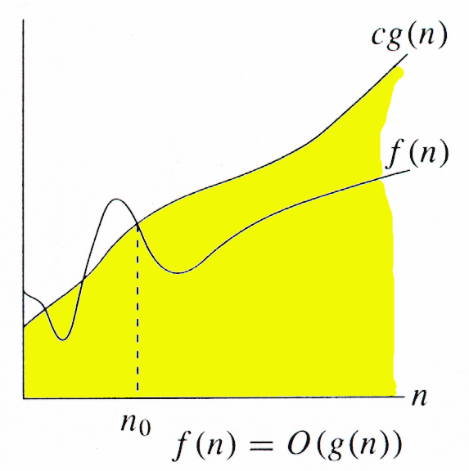
Big-oh notation
The function f(n) = O(g(n)) if and only if there exists positive constants c, n₀ such that
f(n) ≤ cg(n) for ∀ n ≥n₀ , c>0;
Big-oh can be used to denote all upper bounds on the time complexity of an algorithm.
Big-oh also captures the worst case analysis of an algorithm.
Examples: f(n) = 4n+2; g(n) = n
4n+2 ≤ cn, c=5 ∀ n ≥2
4n+2 <= 5n
=> 4n+2 = O(n)
Hence f(n) = O(n)

Slide 35
Big-oh notation…
Note that 4n + 2 ≠ O(1). There does not exist c and n₀ such that, 4n + 2 ≤ c.1 for all n beyond n₀ However large the c is, there exist n beyond which 4n + 2 > c.1.
Note that 4n + 2 is O(n²), O(n3), O(2^{n}), O(10^{n}) as per the definition. i.e., it captures all upper bounds. For the above example, O(n) is a tight upper bound whereas the rest are loose upper bounds.

Slide 36
Exercises – Big-oh
2. 100n + 6 = O(n)
100n + 6 ≤ 101.n, c = 101 ∀n ≥6. One can also write 100n + 6 = O(n³).
3. 10n² + 4n + 2 = O(n²)
4. 3n + 3 = O(2^{n})
5. n³ + n + 5 = O(n³)

Slide 37
o-notation
The asymptotic upper bound provided by O-notation may or may not be asymptotically tight.
The bound 2n²=O(n²) is asymptotically tight, but the bound 2n=O(n²) is not.
Defined as f(n) = o(g(n)) if for any positive constant c > 0, there exists a positive constant n₀ > 0 such that 0 ≤ f(n) < c. g(n) for all n ≥n₀.
Example: 2n = o(n²), but 2n² ≠ o(n²). Note that here n² is polynomially larger than 2n by n^{ε}, ε = 1.

Slide 38
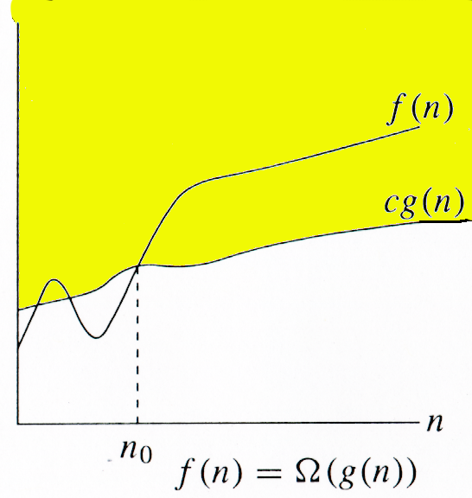
Asymptotic lower bounds - Omega Notation
The function f(n) = Ω(g(n)) if and only if there exists positive constants c, n₀ such that
f(n) ≥ cg(n) for ∀ n ≥n₀ , c>0;
Big-oh can be used to denote all lower bounds on the time complexity of an algorithm.
Big-oh also captures the best case analysis of an algorithm.
Examples: f(n) = 3n+2; g(n) = n
3n+2 ≥ n, c=1 ∀ n ≥1
3n+2 ≥ n
=> 3n+2 = Ω(n)
Hence f(n) = Ω(n)

Slide 39
Exercises - Ω Notation
2. 10n² + 4n + 2 = Ω(n²)
10n² + 4n + 2 ≥ n²
c = 1 ∀ n ≥ 1
3. n3 + n + 5 = Ω(n³)
4. 2n² + n log n + 1 = Ω(n²)

Slide 40
ω-notation
We use ω -notation to denote a lower bound that is not asymptotically tight.
We define ω(g(n)) (little-omega) as f(n) = ω(g(n)) if for any positive constant c > 0, there exists a positive constant n₀ > 0 such that 0 ≤ c.g(n) < f(n) for all n≥n₀.
For example, n² = ω(n) but n² ≠ ω(n²).
3n + 2 = ω(log(n))
10n³ + 4n + 2 = ?
5n⁶ + 7n + 9 = ?
2n² + n log n + 1 = ?

Slide 41
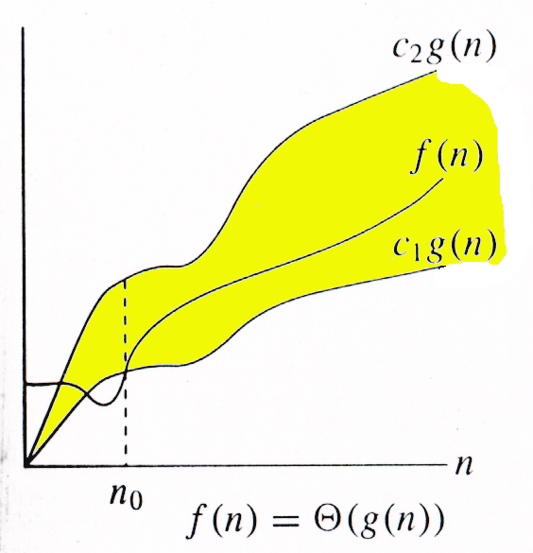
Asymptotic tight bound - Theta Notation
The function f(n) = Ꝋ(g(n)) if and only if there exists positive constants c₁, c₂, n₀ such that
c₁g(n) ≤ f(n) ≤ c₂g(n) for ∀ n ≥n₀ , c₁,c₂>0;
Theta can be used to denote tight bounds of an algorithm.
g(n) is a lower bound as well as an upper bound for f(n).
f(n) = Ꝋ(g(n)) if and only if f(n) = Ω(g(n)) and f(n) = O(g(n)).

Slide 42
Asymptotic tight bound - Examples
3n + 10¹⁰
3n ≤ 3n +10¹⁰ ≤ 4n, c₁ =3, c₂=4 ∀n ≥ 10¹⁰
3n + 10¹⁰ = Ꝋ (n)
Note that the first inequality captures 3n+10¹⁰ = Ω(n) and the later one captures 3n+10¹⁰ = O(n).
2. 10n² + 4n + 2 = Ꝋ(n²)
10n² ≤ 10n² + 4n + 2 ≤ 20n²; ∀n ≥ 1; c₁ = 10; c₂ = 20
3. 6(2^{n}) + n²= ?
4. 2n² + n log n + 1 = ?

Slide 43
Common time complexities
BETTER
WORSE
O(1) constant time
O(log n) log time
O(n) linear time
O(n log n) log linear time
O(n²) quadratic time
O(n³) cubic time
O(2^{n}) exponential time

Slide 44
Iterative Algorithms-1
Test(n){
i=1;
for(i to n){
print(“DSA”);
i++;
}
}
O(n)

Slide 45
Iterative Algorithms-2
Test(n){
i=1,j=1;
for(i to n){
for(j to n){
print(“DSA”);
j++;
}
i++;
}
}
O(n²)

Slide 46
Iterative Algorithms-3
i | 1 | 2 | 3 | 4 | 5
s | 1 | 3 | 6 | 10 | 15
Test(n){
i=1, s=1;
while(s < n){
print(“DSA”);
i++;
s=s+i;
}
}
O(√n)
s is the sum of first i natural numbers.
If the loop runs for k times then the loop condition becomes false when s = k(k+1)/2 >= n
When (k² + k)/2 = n
k = √n

Slide 47
Iterative Algorithms-4
Test(n){
i=1;
while(i² <= n){
print(“DSA”);
i++;
}
}
O(√n)

Slide 48
Iterative Algorithms-5
i | j | k
1 | 1 | 100
2 | 1,2 | 2*100
3 | 1,2,3 | 3*100
4 | 1,2,3,4 | 4*100
n | 1,2,..,n | n*100
Test(n){
i=1,j=1,k=1;
for(; i <n ; i++)
for(; j<n ; j++)
for(; k<100 ; k++)
print(“DSA”);
}
O(n²)
DSA is printed 100+2*100+3*100+…. +n*100
=100(1+2+3+….n)
=100(n(n+1)/2)

Slide 49
Iterative Algorithms-5
i | j | k
1 | 1 | 1*n/2
2 | 4times | 4*n/2
3 | 9times | 9*n/2
n | n²times | n²*n/2
Test(n){
i=1,j=1,k=1;
for(; i <=n ; i++)
for(; j<=i² ; j++)
for(; k<=n/2 ; k++)
print(“DSA”);
}
O(n⁴)
DSA is printed
=n/2(1+4+9+….n²)
=n/2(n(n+1)(2n+1)/6)

Slide 50
Iterative Algorithms-6
i
1 | 2⁰
2 | 2¹
4 | 2²
n | 2^{k}
Test(n){
for(i=1; i<=n ; i=i*2)
print(“DSA”);
}
O(log₂ n)
Suppose i=i*3 then O(log₃ n) and so on
DSA is printed
2^{k}=n
k=log₂ n

Slide 51
Iterative Algorithms-5
Test(n){
i=1,j=1,k=1;
for(i=n/2; i <=n ; i++)
for(j=1; j<=n ; j++)
for(k=1; k<=n ; k*=2)
print(“DSA”);
}
No dependency between loops hence directly we can calculate n/2 * n * log₂n
O(n²log₂n)

Slide 52
Recurrence Relations
As many algorithms are recursive in nature, it is natural to analyze algorithms based on recurrence relations.
Recurrence relation is a mathematical model that captures the underlying time-complexity of an algorithm. To analyze recurrence relations,
- Substitution method,
- Recurrence tree method, and
- Master theorem

Slide 53
Substitution method
Consider a computational problem P and an algorithm that solves P.
Let T(n) be the worst-case time complexity of the algorithm with n being the input size.
For searching and sorting, T(n) denotes the number of
comparisons incurred by an algorithm on an input size n.

Slide 54
Case studies: Searching and Sorting
Linear Search
Input: Array A, an element x.
Question: Is x € A.
- Let T(n) be the number of comparisons (time) required for linear search on an array of size n.
- When n = 1, T(1) = 1.
- T(n) = 1 + T(n-1) = 1 +…+ 1 + T(1) and T(1) = 1
- T(n) = n-1 + 1 = n.
- i.e., T(n) = Ꝋ(n).

Slide 55
Binary search
Input: Sorted array A of size n, an element x to be searched.
Question: Is x € A.
Check whether A[n/2] = x. If x > A[n/2], prune left half, else right half.
T(n) = T(n/2) + 1
= T(n/4) + 1 +1
= T(n/8) + 1+ 1+ 1
= T(n/2³) + 3
…
⁼ T(n/2^{k}) + k => 1 + log₂n => log₂n <= 1+log₂n <= 2log₂n, for all n>=2
= T(1) + k => n/2^{k} = 1, n = 2^{k}; log₂n = log₂k; k= log₂n. T(n) = Ꝋ(n).

Slide 56
Recurrence Relations…
Sorting
To sort an array of n elements using nd-max (returns maximum) as a black box.
Approach: Repeatedly find the maximum element and remove it from the array. The order in which the maximum elements are extracted is the sorted sequence.
T(n) = T(n-1) + n-1 = T(n-2) + n-2 + n-1 = T(1) + 1 + ... + n-1
= (n(n-1))/2
= Ꝋ(n²).

Slide 57
Some exercises
1. Solve T(n) = n + T(n-1), n>1
= 1 , n=1
2. Develop a recurrence relation for finding maximum in an array of n elements and solve.

Slide 58
Answer 1
Solve T(n) = n + T(n-1) n>1
= 1 n=1
T(n) = n+ T(n-1) (1)
T(n-1) = n-1 + T(n-2) (2)
T(n-2) = n-2 + T(n-3) (3)
Back Substituting (2) in (1) we get
T(n) = n+(n-1)+ T(n-2)
n+(n-1)+(n-2)+T(n-3)
n+(n-1)+(n-2)+ ….. + (n-k) + T(n-(k+1))
Here, for n-(k+1)=1
k=n-2
Replacing k=n-2;
T(n) = n+(n-1)+(n-2)+ ….. + (n-n+2) + T(n-(n-2+1))
= n+(n-1)+(n-2)+……+2+1
= n(n+1)/2
T(n) = O(n²)

Slide 59
Answer 2
The base case, T(2) = 1 or T(1) = 0.
Let T(n) denote the worst case number of comparisons to find the maximum, then, T(n) = T(n-1) + 1.
The solution is T(n) = n-1.
Thus, T(n) = Ꝋ(n).

Slide 60
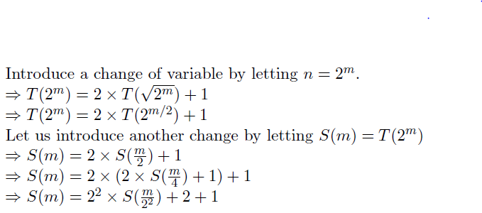
Change of Variable Technique
Solve: T(n) = 2T(√n) + 1 and T(1) = 1

Slide 61
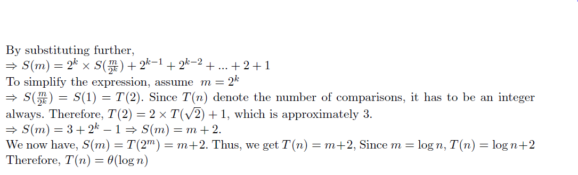
Change of Variable Technique…

Slide 62
Exercises
Solve by change of variable method:
1. T(n) = 2T(√n) + n and T(1) = 1.
2. T(n) = 2T (√n) + log n and T(1) = 1.

Slide 63
Recursive Algorithms
Test(n){
if(n>0)
return n+Test(n-1);
else
return 0;
}
T(n) = 1 + T(n-1) n>0
= 1 n=0

Slide 64
Back Substitution-1
T(n) = 1 + T(n-1) n>0
= 1 n=0
T(n) = 1+ T(n-1)
T(n-1) = 1 + T(n-2)
T(n-2) = 1 + T(n-3)
Back Substituting these values we get
T(n) = k + T(n-k)
Here, for T(0)=1
n-k=0
k=n
Replacing k=n; T(n) = n + T(n-n) = n + T(0) = n+1
T(n) = n
T(n) = O(n)

Slide 65
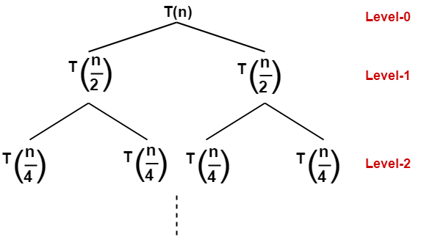
Recursion Tree - 1
T(n) = 2T(n/2) +c n>1
= c n=1
c+2c+4c+8c+nc
c(1+2+4+8+…..+2^{k})
c{1(2^{k+1}-1)/(2-1)}
c(2^{k+1}-1)
c((2^{k} * 2¹ )-1)
c(2n-1)
T(n) = O(n)
T(n/n) ….. T(n/n) …… T(n/n)…..

Slide 66
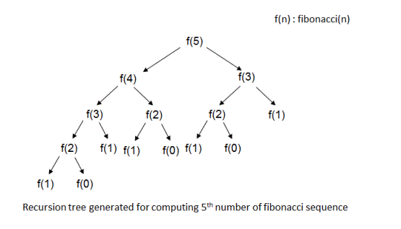
Recursion Tree - 2
Fibo(n){
if(n==0 || n==1)
return n;
else
return fibo(n-1) + fibo(n-2)
}
T(n) = T(n-1)+T(n-2)+c n>1
= c n=0,1
T(n) = O(2^{n})

Slide 67
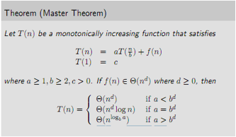
Masters Theorem

Slide 68
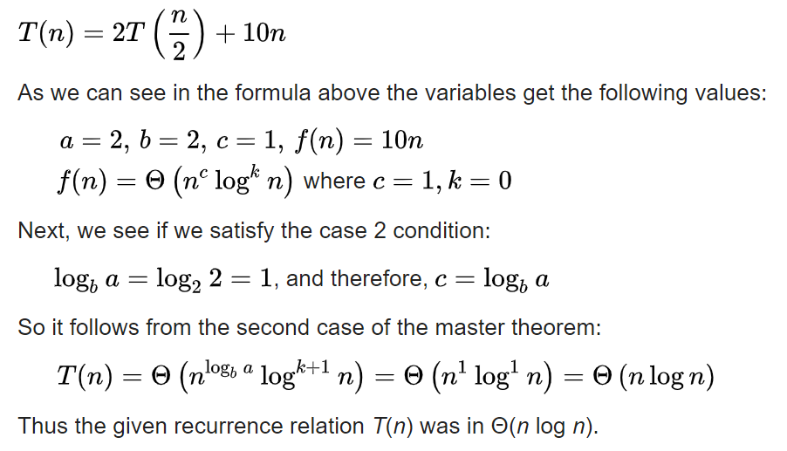
Masters Theorem - Ex1

Slide 69
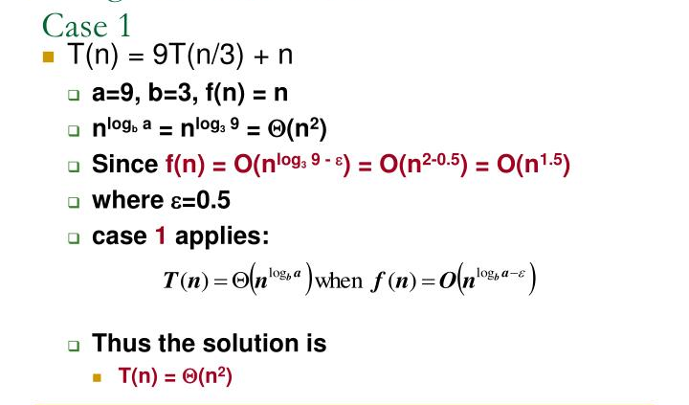
Masters Theorem – Ex2

Slide 70
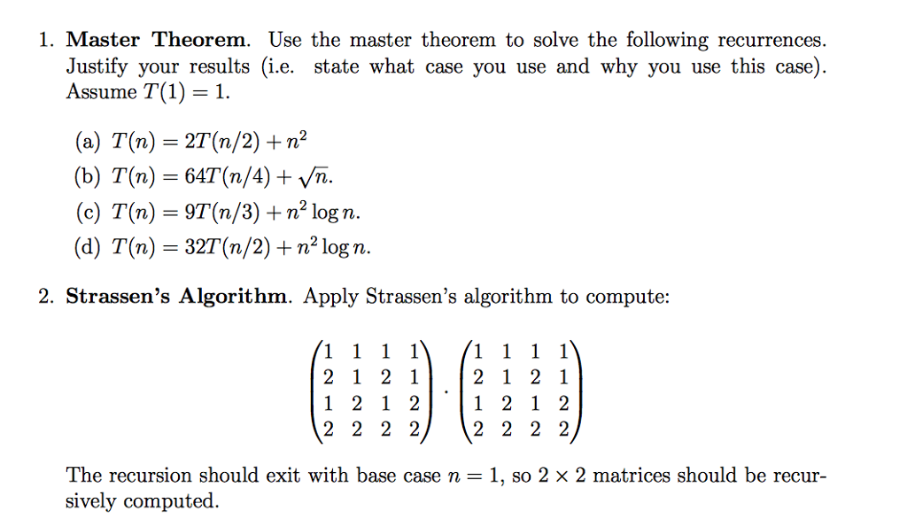
Masters Theorem - Practise

Slide 71
Reading Assignment
Read Chapter 1-3 in [CLRS]
Chapter 1 introduces the notion of an algorithm
Chapter 2 analyzes some sorting algorithms
Chapter 3 introduces Big Oh notation

Slide 72
Thank You

